Slide 1
Kuopio Health Insights
Global Pharma Trends & Future Clinical RDI
Tim Sheppard, Senior Vice President, IQVIA Global Health
General Manager, North Europe, Canada, Australia & New Zealand

Slide 2
OUR VISION
Power smarter healthcare for everyone everywhere
100+
countries
100M+
patient network for
trial recruitment
1.2B+
Non-identified patient records
12,000+
technology experts
11,500+
consultants and service experts
20,000+
clinical research experts
Clinical & real-world research
Global leader in Phase I-IV clinical trials and Real-World Evidence solutions
Innovation, Value & Access
Demonstrating the value of medicines and accelerating innovation uptake at scale
Healthcare System Solutions
Ensure patients have timely & equitable access to clinical research, RWS and innovation
Population Health & Government
Partner to CEPI, WHO & International Government, to support public health, medicines access & pandemic preparedness

Slide 3
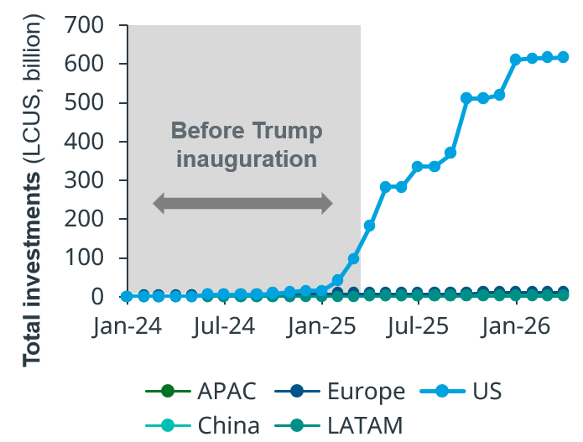
Intergovernmental competition is ramping up following US Policy changes and inbound pledges of investment
Themes driving US policy
Cumulative pledges from top-20 companies
(pre- and post-Trump inauguration)
Themes
“America First”
Government efficiency
“Make America Healthy Again”
Affordable drugs for US consumers
Deregulation
Policies
Tariffs, Deals
Agency restructuring
Regulatory policy
Drug pricing policy, PBM and supply chain
70% of top-20 pharma companies have made a pledge
(vs only 3 of the top-20 generic companies)
Notes: Top 20 pharma based on 2024 FY revenues (IQVIA MIDAS FY 2024). Analysis based on investments in facility upgrades, manufacturing sites, technologies and warehouse expansions announced between 1st Jan 2024 and 14th April 2026. Company acquisitions (ie $16.5 Catalent acquisition by NN) are excluded.
Sources: Company press release, news articles and industry reports, IQVIA MIDAS, IQVIA Thought Leadership
Notes:
Lifesciences are a key strategic sector for health reasons, countries economies and defence reasons. In 2026 we will see clear signs of competition ramping up – this is important and beneficial for society.
EU is focussing on better translating its world leading science base to medicines
2026 will bring negotiations on 10s billions of new biotech r&D and translational funding.
The EU will also simplify its clinical trials process in the biotech act
This act, along with the pharma revision will also accelerate access by 2-4 months
And we will see a decision on EU-wide launch requirements
In the UK, the pressure from Brexit, fiscal sustainabitiyli, the US government and industry are enabling it to undergo radiacl reforms to improve attractiveness.
Like the EU, it will also acceslerate its clinical trial timelines to an impressive submission to start of 150 days.
The firs innovative products will also be passing through ILAP and we will get better feel for how effective it is
UK also has a 10 year plan to improve access to innovation through quickening NHS access or permitting data reuse.
China
Decades of government support is increasingly paiying dividencd, nect year China may catch up with US scientific impact, as measured by citations
On the translational side, Clinial trial approvals are also dropping to a rapid 30 days.
Data protection is also being introduces to encouraged innovative medicines to launch earlier in china
US. In this competition, the US is taking a protectionist approach, prioritising national interest over innovation
2026 will see NIH cuts deepend and the impacts that that has on the US early science will become clearer
BIOSECURE act will be implementing, preventing colaboratin with certain (Chinese) biopharma companies
Similarly, licensing restrictions will alsoprevent commercial tie ups in key biopharma areas
Tariffs, everyones favourite, will have been implemented, or not, and if implemented will be reducing US access to certain innovative medicines.

Slide 4













The traditional launch sequence is being challenged –
new priority markets emerge
Policy reform is key to boost Europe’s competitiveness & prepare for MFN impact
NAS launch lag timeline
2020-2024 launches
United States
European average
EU4
United Kingdom
Rest of Europe
-7.8m
Middle East
UAE, KSA and China
may soon overtake
EU4 and UK markets
-17.6m
China
-21.8m
Launch lag (months)
Denotes change from 2020-2024 vs. 2015-2019 launches
Notes: Launch lag refers to the average difference in launch time compared to the first global launch for NAS; launch date calculated using MIDAS sales; EU average refers to 29 countries average
Source: IQVIA MIDAS; IQVIA Thought Leadership analysis
Notes:
UK’s 5 Most Impactful Measures to Attract Pharma Investment
1. Pricing & Access Reform (VPAG + NICE thresholhds)
New VPAG scheme replaces VPAS, reducing punitive rebate rates and improving commercial predictability.
2. Faster Regulatory Approvals
Faster Clinical trials, First ILAP products, MHRA’s International Recognition Framework and NICE’s proportionate appraisals cut time-to-market for innovative medicines.
5. AI-Ready Health Data Platform
Building secure, interoperable health data infrastructure to enable AI-driven drug discovery and clinical trials.

Slide 5
Innovation continues to accelerate, challenging health systems
24-28
CAGR
Top 20 TAs
2028F Global Spend (constant $Bn)
65-75 NAS
to launch annually over the next 5 years
Oncology
16%
Immunology
4%
Diabetes
5%
Innovation hotspots
Oncology
Obesity
Cardiovascular
4%
Immunology
CV-Met
CNS
8%
Multi-indication
launches
increasingly important and successful in oncology,
CV-Met, immunology
Respiratory
5%
Obesity*
25%
$139Bn: Upper-case scenario
*Based on mid-point scenario;
Notes: * – Ex-flu and Covid; Median cumulative sales value (million USD) pre and post-pandemic. Pre-pandemic launches: H2 2017 to 2019; Includes NAS launches as well as other launches considered to be significantly innovative (e.g. non-NAS launches in a new therapy area, orphan disease or new combinations including an innovative branded medicine); Excludes Hep C products, COVID-19 Vaccines and Treatments; Countries included are US, CN, JP, UK, DE, IT, FR, ES;
Source: ¹Global Use of Medicines 2024: Outlook to 2028. Report by the IQVIA Institute for Human Data Science, ²IQVIA Thought Leadership analysis as of June 2024, ³IQVIA EMEA Thought Leadership, ⁴IQVIA MIDAS Monthly May 2024; Copyright © 2025 IQVIA. All rights reserved; Abbreviations: NAS – New Active substances, CV-Met – Cardiovascular-Metabolic, CAGR – Compound Annual Growth Rate, Bn – Billion

Slide 6
Obesity innovation: 157 assets in pipeline; Evidence of
GLP-1 real-world benefits
Clinical obesity pipeline by MoA
(Phase 1 to pre-registration)
GLP-1s found to have real-world benefits
Recent study finds benefits in 42 indications
Not specified
Renal
Reduced risk
Heart disease/
cardiovascular
Reduced risk
GLP-1
Alzheimer’s
  Reduced risk
US Dept. Veteran Affairs:
215,970 diabetics on GLPs vs. controls on other meds
Cancers
Reduced risk
Other
(50 MoAs)
n = 157
GLP-1/
GIP
Psychotic disorders
Reduced risk
Activin/
myostatin
Amylin
GLP-1/glucagon
GI disorders, syncope, joint pain
Increased risk
Substance abuse disorders
Reduced risk
Leptin
GLP-1/GIP/
glucagon
ghrelin
GLP-1/
amylin
NLRP3
GLP-1/
FGF21
CB1
Source: IQVIA Analytics Link; Clinicaltrials.gov; company reports, press releases, desk research; IQVIA EMEA Thought Leadership analysis; December 2024, Note: List of companies is not exhaustive.

Slide 7
Private spending on anti-obesity medications could reach over $100bn by the end of the decade
Global Obesity Spending & Forecast
Potential for $100bn - $200bn+ by 2030
~$36bn in 2024 at list prices
Sources: IQVIA Global Use of Medicines Report, WHO Health Expenditure Database, OECD Health Statistics

Slide 8
Deal-making activity surges
Clinical trial starts higher than pre-pandemic levels
Global Trends in R&D 2026
Novel active substance approvals remain elevated
Research Productivity measures remain challenging
Accelerating use of productivity enablers

Slide 9

AI Accelerators Clinical Research
Safety Monitoring
Study Operations & Data Management
Protocol Design
Site Selection & Feasibility
Patient Identification & Recruitment
Notes:
Patient identification & recruitment: Through the analysis of EHR, claims data, structured/unstructured data AI can enable the identification of protocol matched patients at speed. Our own Patient Finder solution is very much enabled by AI.
Site selection & feasibility: AI can predict which sites are most likely to recruit patients successfully based on historical performance, disease prevalence, investigator experience & competing studies. This ensures fewer non-performing sites accelerating trial delivery, study footprint but also reducing costs.
Protocol design: AI can assess eligibility criteria, identify recruitment bottlenecks & optimise protocols. This in terms ensure more feasible protocols with fewer amendments. (IQVIA – DIPA tool)
Study Operations & Data Management: Large amounts of clinical trial processes are still very manual so there is a great opportunity to use AI in data entry (e2e); document review; query resolution. This in turn should improve quality, investigator burden & reduce cost
Safety monitoring: AI can monitor safety signals across large amounts of data enabling earlier identification & improved safety.

Slide 10
Emerging Bio-Pharma trial starts have seen significant growth, outperforming ‘large’ Pharma
Globally, EBP originated 61% of new drugs in 2025 and launched 81% of those they discovered
EBP pre-commercial
EBP commercial
Small
Mid
Large
Source: Citeline Trialtrove, Jan 2026; IQVIA Institute, Feb 2026.
Report: Global Trends in R&D 2026. IQVIA Institute for Human Data Science.

Slide 11
Global trials sponsored by China-headquartered companies see a significant uplift in the last decade, stabilized at ~32%
Phase I to III trial starts based on sponsor headquarters location, 2009–2025

Slide 12

At IQVIA, the Nordics delivered 2,572 patient recruitments across 78 protocols and 55 sponsors (2024 – 2026 YTD)
Key therapeutic areas include: Neurology, Ophthalmology, Hematology, Oncology and Infectious Disease.
The Nordic countries are uniquely positioned for rare disease research because of:
    Centralised healthcare systems
    Healthcare data and national registries
    Specialist referral centres
    Strong longitudinal patient follow-up
    Efficient patient identification
Investigator-Led Networks: TRICALS (ALS), EPON (Oncology), Neurology & Opthalmology
Cutting Edge Development: Phase 1 Oncology; precision medicine & biomarker neurology programmes
1
2
3
4
5
Finland performance primarily driven by
Helsinki University Hospital
Finnish Vaccine Research Network
Turku and Oulu research centres

Slide 13
Questions?

