Slide 1
Finnish Drug Discovery Center - part of the drug development ecosystem in Finland
Maarit Merla, CEO
August 13th, 2024

Slide 2
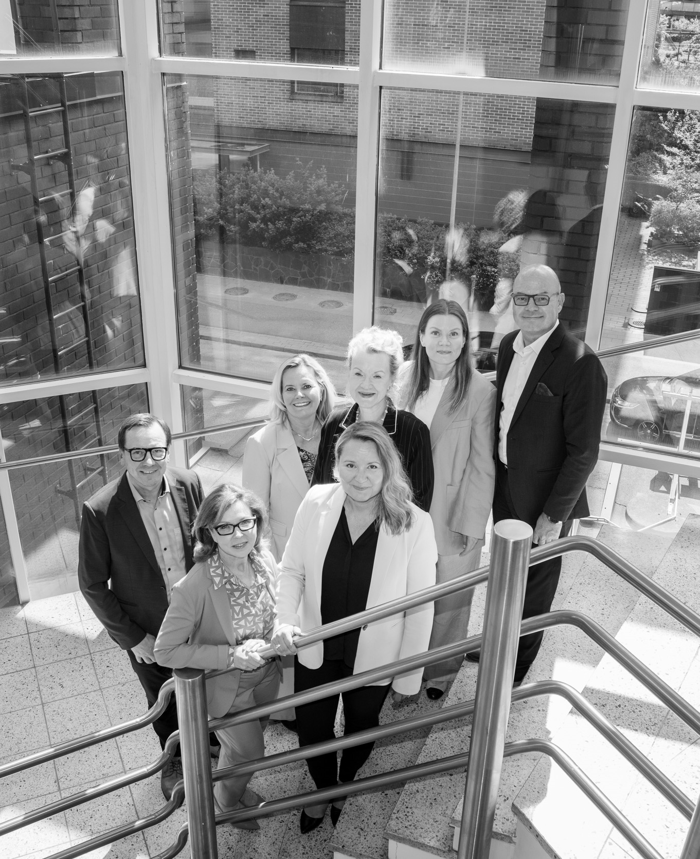
Finnish Drug Discovery Center Ltd is a company with special assignment. The company purpose is to promote competitive drug development and overall commercial success of Finland in this sector.
FDDC is fully state-owned and belongs to the administrative branch of the Ministry of Economic Affairs and Employment in Finland.
The company serves universities and research institutes, operators in drug research and companies in the sector across Finland.
Mission: We are a valued partner of the research community in developing innovative drug compounds on their path to international success

Slide 3
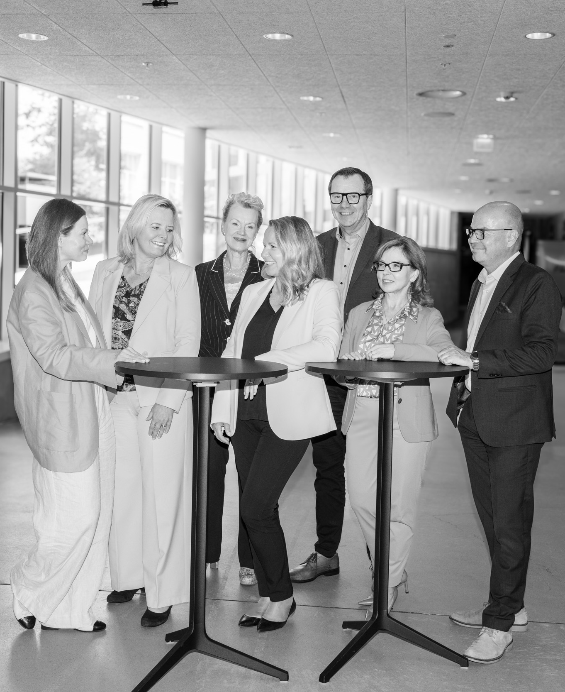
Focus of drug compounds
Small molecules and biological drugs across all therapeutic areas
Sources of drug targets and compounds
Medical universities and companies
Resources
Team: max 10
Capital Investment: €20M
Office location
Lemminkäisenkatu 14 A
Turku, Finland

Slide 4
Board of Directors:
Jyrki Liljeroos, Senior Ministerial Adviser and Board Professional, Chairman of the Board
Liisa Huhtala, Senior Ministerial Adviser at the Ministry of Economic Affairs and Employment, Vice-Chair of the Board
Tuula Helander, Deputy Director General, Biotechnology and Medicines unit, Ministry of Social Affairs and Health
Terhi Horppu, CFO, Blueprint Genetics Ltd
Anne Portaankorva, Vice Rector for Research and Sustainability, Professor in Neurology, University of Helsinki
Ilpo Tolonen, CEO, Docrates Cancer Center
Jukka Westermarck, Professor, cancer biology, University of Turku
Board secretary: Tarja Enala, Head of Health 360 program, Business Finland

Slide 5
Advancing drug target and compound discovery
We help identify and evaluate promising drug compounds, from target identification and first molecule screening stage onwards
We steer and consult on planning the development phases of the drug compounds selected for the portfolio
Our experienced team has expertise in medicinal chemistry, pharmacology, toxicology, regulatory requirements and preclinical planning
We drive the development of drug molecules through to the end of the preclinical research stage
We also help our partners in selecting suppliers and establishing supply chains

Slide 6
Building strong networks
Finding the right partners and creating networks as early as possible are both crucial to the success of the drug development process
We help establish connections with international investors and expand the network of stakeholders operating in the drug development sector
We help build a channel to international financing and commercial success, and expand cooperation networks both within the drug development supply chain and with selected stakeholders
Our work will increase the awareness and recognition of Finland’s drug development ecosystem

Slide 7
Investing in drug discovery and development
As a limited liability company, our goals is profitable business, while simultaneously promoting the success of promising Finnish drug compouds
We can invest in companies and projects developing drug compounds, e.g. through capital investments, by licensing IP rights, by selling consulting services or by negotiating success-fee-based agreements
The most suitable business model will be negotiated on a case-by-case basis

Slide 8
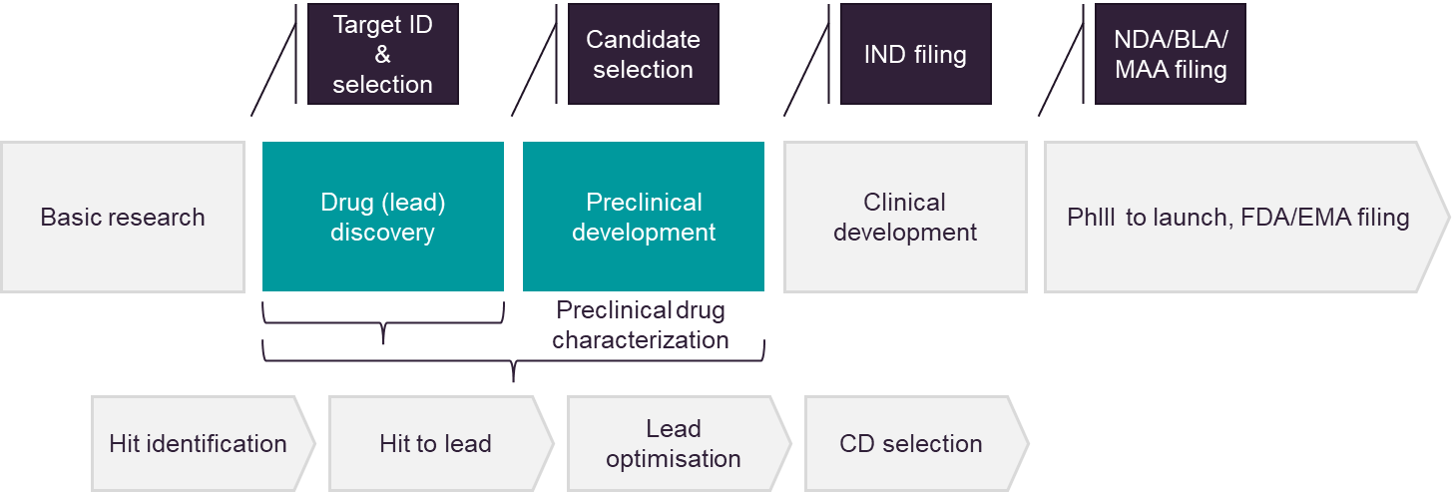
Company position in drug development (small molecule example)

Slide 9
Long Term Strategic Goals
Increased number of commercialized drug compounds originating from Finland
Company investments bring significant value
Company operations have measurable impact on society
The company and Finland are viewed as valued partners in the drug discovery sector

Slide 10
Goals for 2024
Building the team: key capabilities and management system
Business models: services, case modelling & budgeting
Networking and negotiations with key stakeholders
First program into development portfolio
Communication strategy and action plan

Slide 11
Team recruiting plans
Company success requires experienced team of experts in early drug development
Recruiting up to 10 experts during 2024-2025:
Medicinal chemistry
Pharmacology
Nonclinical development
Business Development and financing
Pekka Kallio, Ph.D., Associate Professor, appointed Chief Scientific Officer, August 1st 2024

Slide 12
Mission: We are a valued partner of the research community in developing innovative drug compounds on their path to international success

Slide 13
Maarit Merla
CEO
+358 40 3108023
maarit.merla@ddcenter.fi

